Slide 1
Mathematical Modeling and Engineering Problem solving Chapter 1

Slide 2
Numerical Methods
Numerical methods are techniques by which mathematical problems are formulated so that they can be solved with arithmetic operations.
Pre-computer Era:
Analytical Solution
Graphical
Calculator

Slide 3
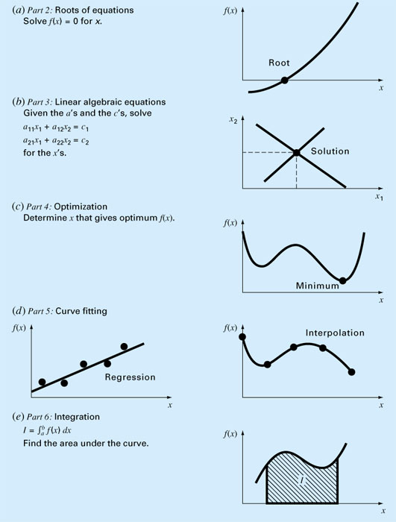
Every part in this book requires some mathematical background

Slide 4
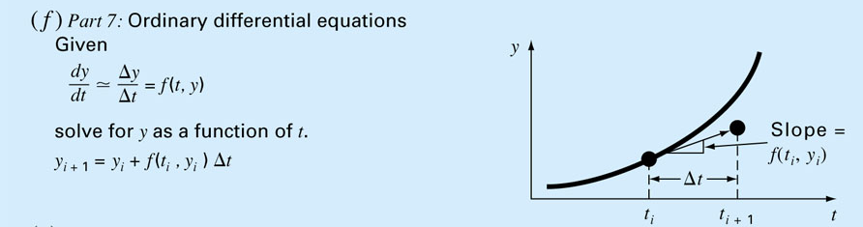
Computers are great tools,
however, without fundamental understanding of engineering problems, they will be useless.

Slide 5
Engineering Simulations
Benefits of Simulations
Cost savings by minimizing material usage.
Increased speed to market through reduced product development time.
Optimized structural performance with thorough analysis
Eliminate expensive trial-and-error.

Slide 6
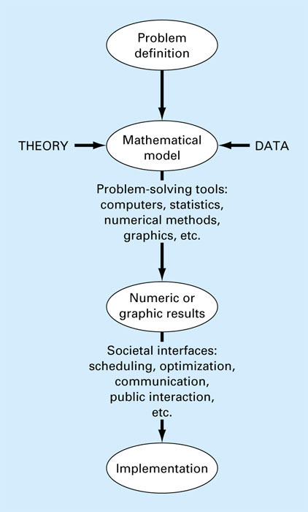
The Engineering
Problem Solving
Process

Slide 7
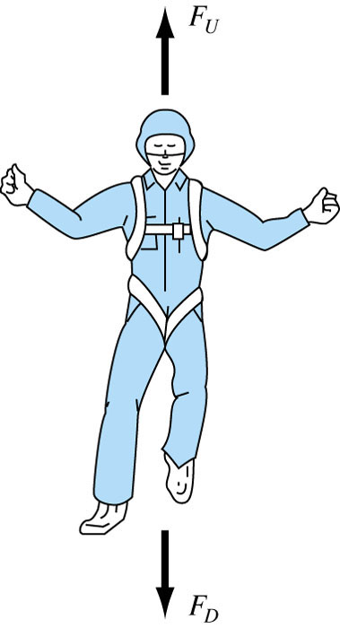
Newton’s 2nd law of Motion
“The time rate change of momentum of a body is equal to the resulting force acting on it.”
Formulated as F = m.a
F = net force acting on the body
m = mass of the object (kg)
a = its acceleration (m/s²)
Some complex models may require more sophisticated mathematical techniques than simple algebra
Example, modeling of a falling parachutist:
F_{U} = Force due to air resistance = -cv (c = drag coefficient)
F_{D} = Force due to gravity = mg

Slide 8
This is a first order ordinary differential equation. We would like to solve for v (velocity).
It can not be solved using algebraic manipulation
Analytical Solution:
If the parachutist is initially at rest (v=0 at t=0), using calculus dv/dt can be solved to give the result:
Independent variable
Dependent variable
Forcing function
Parameters

Slide 9
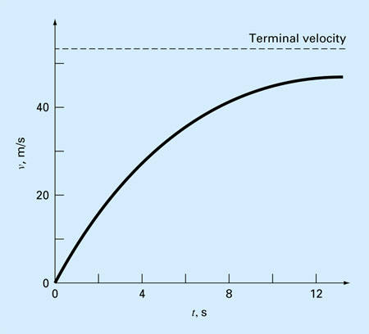
Analytical Solution
If v(t) could not be solved analytically, then
we need to use a numerical method to solve it
g = 9.8 m/s² c =12.5 kg/s
m = 68.1 kg
t (sec.) | V (m/s)
0 | 0
2 | 16.40
4 | 27.77
8 | 41.10
10 | 44.87
12 | 47.49
∞ | 53.39

Slide 10
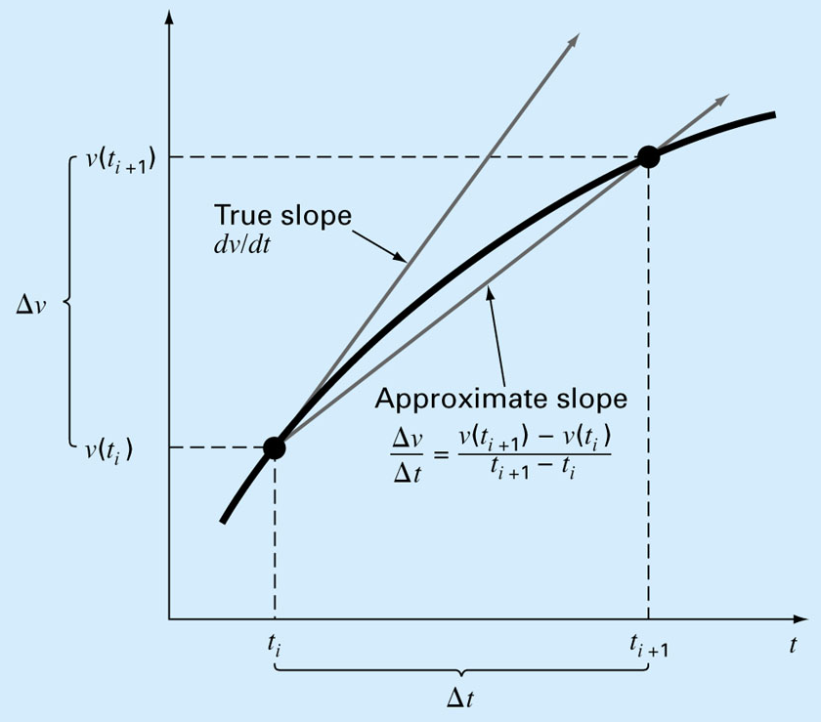
Numerical Solution
This equation can be rearranged to yield
t (sec.) | V (m/s)
0 | 0
2 | 19.60
4 | 32.00
8 | 44.82
10 | 47.97
12 | 49.96
∞ | 53.39
∆t = 2 sec
To minimize the error, use a smaller step size, ∆t
No problem, if you use a computer!

Slide 11
Analytical
vs.
Numerical solution
m=68.1 kg c=12.5 kg/s
g=9.8 m/s
∆t = 2 sec
∆t = 0.5 sec
∆t = 0.01 sec
t (sec.) | V (m/s)
0 | 0
2 | 16.40
4 | 27.77
8 | 41.10
10 | 44.87
12 | 47.49
∞ | 53.39
t (sec.) | V (m/s)
0 | 0
2 | 19.60
4 | 32.00
8 | 44.82
10 | 47.97
12 | 49.96
∞ | 53.39
t (sec.) | V (m/s)
0 | 0
2 | 17.06
4 | 28.67
8 | 41.95
10 | 45.60
12 | 48.09
∞ | 53.39
t (sec.) | V (m/s)
0 | 0
2 | 16.41
4 | 27.83
8 | 41.13
10 | 44.90
12 | 47.51
∞ | 53.39
CONCLUSION: If you want to minimize the error, use a smaller step size, ∆t

Slide 12
